Slide 1
Course Code: AI203 Course Name: Data Structures & Algorithms
Prof. Pragati P. Patil

Slide 2
Unit – II : Linear Data Structures
Stack: Definition, Representation and Applications of Stack.
Queue: Definitions, Representation and Applications of Linear Queue, Circular Queue, and Priority Queue.

Slide 3
Introduction to Array
An array is defined as a set of finite number of homogeneous elements or same data items.
It means an array can contain one type of data only, either all integer, all float-point number or all character.
Simply, declaration of array is as follows: int arr[10] ;
Where int specifies the data type or type of elements arrays stores.
“arr” is the name of array & the number specified inside the square brackets is the number of elements an array can store; this is also called sized or length of array.

Slide 4
Introduction to Array
The elements of array will always be stored in the consecutive (continues) memory location.
The number of elements that can be stored in an array, that is the size of array or its length is given by the following equation: (Upperbound - lowerbound)+1
For the above array it would be (9-0)+1=10,where 0 is the lower bound of array and 9 is the upper bound of array.
Array can always be read or written through loop.
for(i=0;i<=9;i++)
{
scanf(“%d”,&arr[i]);
printf(“%d”,arr[i]);
}

Slide 5
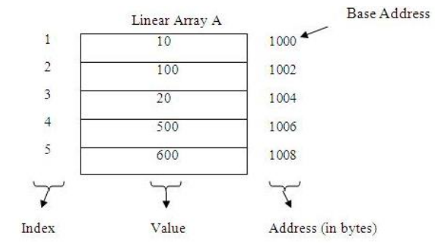
Memory Allocation of Array
The elements of linear array are stored in consecutive memory locations. It is shown below:
Address of element a[k]=B + w * k

Slide 6
Types of Array
Single Dimension Array
◦ Array with one subscript
Two Dimension Array
◦ Array with two subscripts (Rows and Column)
Multi Dimension Array
◦ Array with Multiple subscripts

Slide 7
Basic operations of Array
Some common operation performed on array are:
◦ Traversing
◦ Searching
◦ Insertion
◦ Deletion
◦ Sorting
◦ Merging

Slide 8
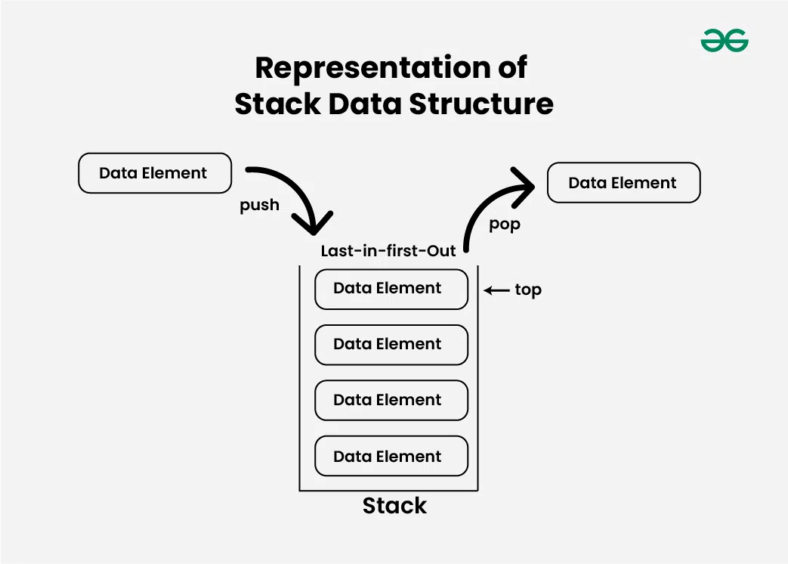
Stack
Stack is used as Linear data structure which can be accessed from only one end .
LIFO implies that the element that is inserted last, comes out first and FILO implies that the element that is inserted first, comes out last.
Stack is Ordered List of Elements of Same Type.
Stack is Linear List
In Stack all Operations such as Insertion and Deletion are permitted at only one end called Top.

Slide 9

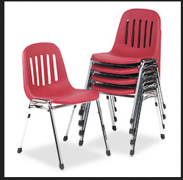
Stack
Common Example :
Suppose at your home you have multiple chairs then you put them together to form a vertical pile.
From that vertical pile the chair which was placed first is removed last. In this way we can see how stack is related to us.

Slide 10
Types of Stack
Fixed Size Stack :
Stack has a fixed size and cannot grow or shrink dynamically.
If the stack is full and an attempt is made to add an element to it, an overflow error occurs.
If the stack is empty and an attempt is made to remove an element from it, an underflow error occurs.
Dynamic Size Stack :
A dynamic size stack can grow or shrink dynamically.
When the stack is full, it automatically increases its size to accommodate the new element.
When the stack is empty, it decreases its size.
This type of stack is implemented using a linked list, as it allows for easy resizing of the stack.

Slide 11
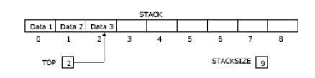
Array Representation of Stack in C Programming
1-D array is used to hold the element of the stack.
Variable “top” keeps track of “Topmost” Element in the stack.
“MAX” is used as Constant which gives maximum size of Stack.

Slide 12
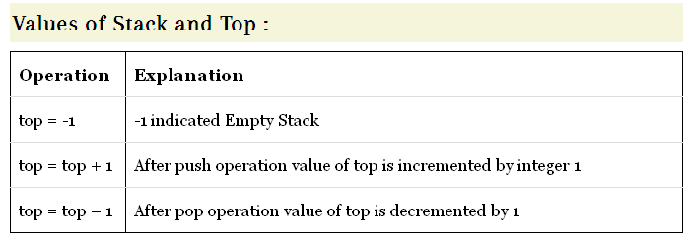
Values of stack and top

Slide 13
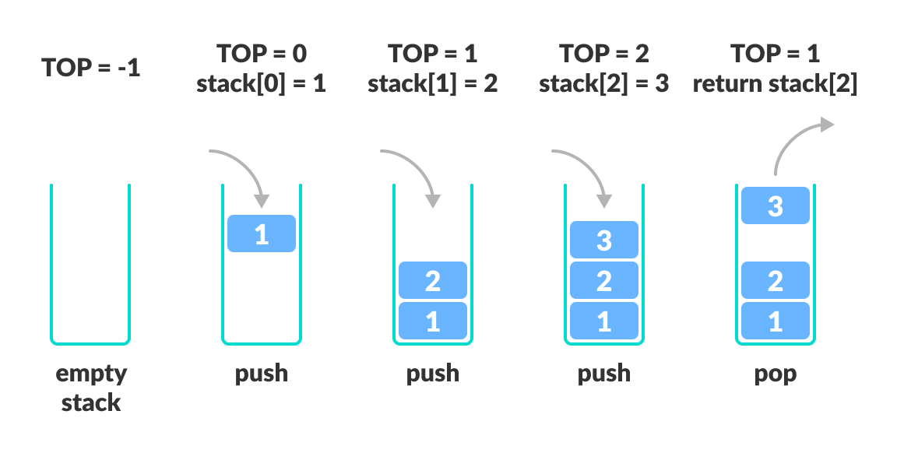
Values of stack and top

Slide 14
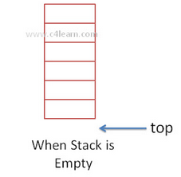
Visual Representation of Stack
View 1 : When Stack is Empty
When Stack is said to empty then it does not contain any element inside it.
Whenever the Stack is Empty the position of topmost element is -1.

Slide 15
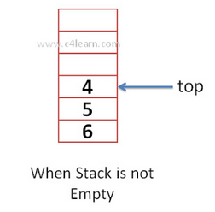
Visual Representation of Stack
View 2 : When Stack is Not Empty
Whenever we add very first element then topmost position will be incremented by 1.
After adding First Element top = 0.

Slide 16
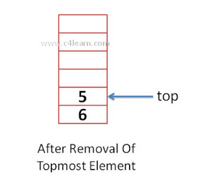
Visual Representation of Stack
View 3 : Deletion of 1 element
After Deletion of 1 Element Top Will be Decremented by 1

Slide 17
Basic Operations on Stack
In order to make manipulations in a stack, there are certain operations provided to us.
push() to insert an element into the stack
pop() to remove an element from the stack
top() Returns the top element of the stack.
isEmpty() returns true if stack is empty else false.
isFull() returns true if the stack is full else false.
To implement stack, we need to maintain reference to the top item.

Slide 18
Push Operation on Stack
Stacks may be represented in the computer in various ways, usually by means of a one-way list or Linear array STACK .
A variable TOP, which contains the location of the top element of the stack, and a variable MAX which gives the maximum number of elements that can be held by the array STACK.
The condition TOP = -1 or TOP = NULL will indicate that the stack is empty.
The condition TOP = MAX-1 will indicate that the stack is full.

Slide 19
Push Operation on Stack
The steps involved in the PUSH operation is given below:
In executing the procedure PUSH, one must first test whether there is space in the stack for the new item(If(TOP=MAX-1)).
If stack if full, then we have the condition known as overflow.
When we initialize a stack, we set the value of top as -1 to check that the stack is empty.
When the new element is pushed in a stack, first, the value of the top gets incremented, i.e., top=top+1, and the element will be placed at the new position of the top.
The elements will be inserted until we reach the max size of the stack.

Slide 20
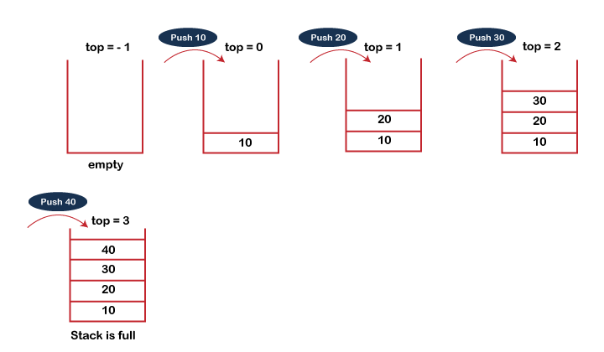
Algorithm for Push Operation on Stack
PUSH(STACK, ITEM)
//This procedure inser the top element of STACK and assigns it to the variable ITEM.
Step-1: If TOP = Max-1
Print “Overflow”
Goto Step 4
Step-2: Set TOP= TOP + 1 (Increased top by 1)
Step-3: Set Stack[TOP]= ELEMENT
Step-4: END

Slide 21
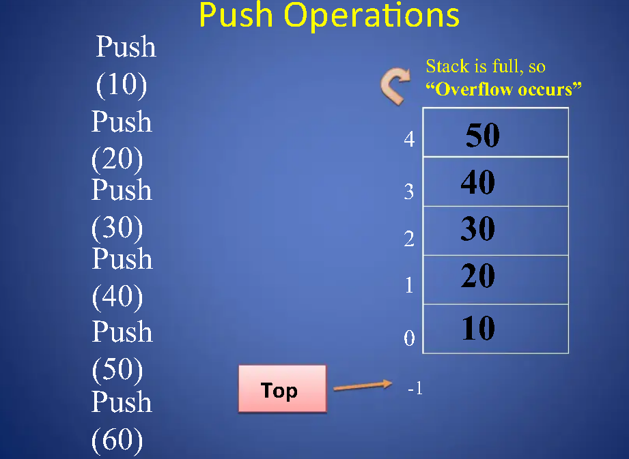

Slide 22
POP Operation on Stack
While executing the procedure POP, we must first test whether there is an element in the stack to be deleted
If there is no element to delete (If(TOP<0)or(TOP==-1)) then there is the condition known as underflow.
If element for deletion is available in stack then first remove that element from stack (Item=Stack[TOP]) and then decrease TOP by 1 (TOP=TOP-1).

Slide 23
POP Operation on Stack
The steps involved in the POP operation is given below:
Before deleting the element from the stack, we check whether the stack is empty.
If we try to delete the element from the empty stack, then the underflow condition occurs.
If the stack is not empty, we first access the element which is pointed by the top.
Once the pop operation is performed, the top is decremented by 1, i.e., top=top-1.

Slide 24
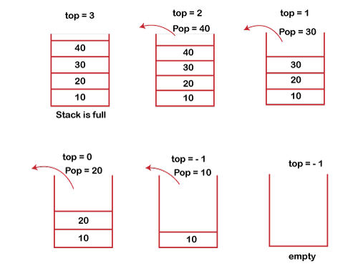
Algorithm: POP Operation on Stack
POP(ITEM)
//This procedure deletes the top element of STACK and assigns it to the variable ITEM.
Step-1: If TOP= 0 or TOP=-1
Print “Underflow”
Goto Step 4
Step-2: Set VAL= Stack[TOP] (assign top ele. to val)
Step-3: Set TOP= TOP-1 (Decreased top by 1)
Step-4: END

Slide 25
PEEK Operation on Stack
When we need to return the value of the topmost element of the Stack without deleting it from the Stack, the Peek operation is used.
This operation first checks if the Stack is empty, i.e., TOP = NULL; if it is so, then an appropriate message will display, else the value will return.
Algorithm:
Step-1: If TOP = NULL
PRINT “Stack is Empty”
Goto Step 3
Step-2: Return Stack[TOP]
Step-3: END

Slide 26
Animation
https://yongdanielliang.github.io/animation/web/Stack.html

Slide 27
C Program of Stack Using Array
#include<stdio.h> int stack[100], choice, n, top, x, i; void push(void); void pop(void); void display(void); int main() { top=-1; printf("\n Enter the size of STACK"); scanf("%d", &max); printf("\n\t 1.PUSH\n\t 2.POP\n\t 3.DISPLAY\n\t 4.EXIT"); do { printf("\n Enter the Choice:"); scanf("%d",&choice);
switch(choice) {
case 1: { push();
break; }
case 2:{ pop(); break; } case 3: { display(); break; } case 4: { printf("\n\t EXIT POINT "); break; } default: { printf ("\n\t Please Enter a Valid Choice(1/2/3/4)"); } } } while(choice!=4); return 0;}

Slide 28
C Program of Stack Using Array
void push() { if(top==max-1) { printf("\n\tSTACK is over flow"); } else { printf(" Enter a value to be pushed:"); scanf("%d",&x); top=top+1; stack[top]=x; } } void pop() { if(top==-1) { printf("\n\t Stack is under flow"); } else { item=stack[top]; top=top-1;; printf("\n\t The popped elements is %d",item); } }
void display() { if(top>=0) { printf("\n The elements in STACK \n"); for(i=top; i>=0; i--) printf("\n%d",stack[i]); } else { printf("\n The STACK is empty"); } }

Slide 29
Applications of Stack
A Stack can be used for evaluating expressions consisting of operands and operators.
Stacks can be used for Backtracking, i.e., to check parenthesis matching in an expression.
It can also be used to convert one form of expression to another form.
It can be used for systematic Memory Management.

Slide 30
Advantages of Stack
A Stack helps to manage the data in the ‘Last in First out’ method.
When the variable is not used outside the function in any program, the Stack can be used.
It allows you to control and handle memory allocation and deallocation.
It helps to automatically clean up the objects.

Slide 31
Disadvantages of Stack
It is difficult in Stack to create many objects as it increases the risk of the Stack overflow.
It has very limited memory.
In Stack, random access is not possible.

Slide 32
Q. 1 Consider the following stack of city names: STACK: London, Berlin, Rome, Paris, _____, _____
Examine the stack contents as the following operations take place:
1. PUSH(STACK, Athens)
2. POP(STACK, ITEM)
3. POP(STACK, ITEM)
4. PUSH(STACK, Madrid)
5. PUSH(STACK, Moscow)
6. POP(STACK, ITEM)
7. PEEK

Slide 33
Answer: INITIAL STACK: London, Berlin, Rome, Paris, _____, _____
Step-by-step process:
PUSH(STACK, Athens): Add "Athens" to the stack. Stack after operation: London, Berlin, Rome, Paris, Athens, _____
POP(STACK, ITEM): Remove the topmost element from the stack, which is "Athens". Stack after operation: London, Berlin, Rome, Paris, _____, _____ ITEM removed: Athens
POP(STACK, ITEM): Remove the next topmost element from the stack, which is "Paris". Stack after operation: London, Berlin, Rome, _____, _____, _____ ITEM removed: Paris
4. PUSH(STACK, Madrid): Add "Madrid" to the stack. Stack after operation: London, Berlin, Rome, Madrid, _____, _____
5. PUSH(STACK, Moscow): Add "Moscow" to the stack. Stack after operation: London, Berlin, Rome, Madrid, Moscow, _____
6. POP(STACK, ITEM): Remove the topmost element from the stack, which is "Moscow". Stack after operation: London, Berlin, Rome, Madrid, _____, _____ ITEM removed: Moscow
Final Stack: London, Berlin, Rome, Madrid, _____, _____
Removed Items (in order): Athens, Paris, Moscow

Slide 34
Q. 2 Consider the following stack of integers: STACK: 10, 20, 30, 40, ___, ___
Examine the stack contents as the following operations take place:
1. PUSH(STACK, 50)
2. POP(STACK, ITEM)
3. PUSH(STACK, 60)
4. PUSH(STACK, 70)
5. POP(STACK, ITEM)
6. POP(STACK, ITEM)
7. PUSH(STACK, 80)
Final Answers:
1. Values popped from the stack:
2. Number of elements remaining in the stack:

Slide 35
Answer: INITIAL STACK: 10, 20, 30, 40, ___, ___
Step-by-step process:
PUSH(STACK, 50): Add “50" to the stack. Stack after operation: 10, 20, 30, 40, 50, _____
POP(STACK, ITEM): Remove the topmost element from the stack, which is “50". Stack after operation: 10, 20, 30, 40, _____, _____ ITEM removed: 50
PUSH(STACK, 60): Add “60” to the stack. Stack after operation: 10, 20, 30, 40, 60, _____
PUSH(STACK, 70): Add “70" to the stack. Stack after operation: 10, 20, 30, 40, 60, 70
5. POP(STACK, ITEM):
Remove the topmost element (70) from the stack.
ITEM: 70
STACK: 10, 20, 30, 40, 60, _____
6. POP(STACK, ITEM):
Remove the topmost element (60) from the stack.
ITEM: 60
STACK: 10, 20, 30, 40, _____, _____
7. PUSH(STACK, 80):
Add 80 to the stack.
STACK: 10, 20, 30, 40, 80, _____
Final Answers:
1. Final state of the stack:
STACK: 10, 20, 30, 40, 80
2. Values popped from the stack:
50, 70, 60
3. Number of elements remaining in the stack:
5 elements (10, 20, 30, 40, 80)

Slide 36
Q. 3 Consider the following stack of integers: STACK: A, B, C, _____, _____, _____
Examine the stack contents as the following operations take place:
PUSH(STACK, D)
PUSH(STACK, E)
POP(STACK, ITEM)
PUSH(STACK, F)
POP(STACK, ITEM)
POP(STACK, ITEM)
PUSH(STACK, G)

Slide 37
Q. 4 Consider the following stack of integers: STACK: 1, 2, 3, _____, _____, _____, _____
Examine the stack contents as the following operations take place:
1. PUSH(STACK, 4)
2. POP(STACK, ITEM)
3. PUSH(STACK, 5)
4. PUSH(STACK, 6)
5. POP(STACK, ITEM)
6. PUSH(STACK, 7)
7. PUSH(STACK, 8)
8. POP(STACK, ITEM)
9. POP(STACK, ITEM)
10. PUSH(STACK, 9)
11. PUSH(STACK, 10)
12. POP(STACK, ITEM)

Slide 38
Stack Applications
1. Expression Evolution
2. Expression conversion
a. Infix to Postfix.
b. Infix to Prefix.
c. Postfix to Infix.
d. Prefix to Infix.
3. Parsing
4. Simulation of recursion
5. Function call

